Slide 1

FOREST FIRE DETECTION AND EXTINGUISH
SUBMITTED TO :- Md. Amir Khan
(TECHNICAL TRAINER)

Slide 2
FOREST FIRE DETECTION AND EXTINGUISH
CONTENT
Group members
Hardware and Software
About the hardware materials
Execution of project
Work done by team
What we thought new
Motivation
Blueprint

Slide 3
FOREST FIRE DETECTION AND EXTINGUISH
GROUP MEMBER
RISHABH TRIPATHI (171500259)
PANKAJ KUMAR (171500215)
KAPIL KUMAR (171500154)
GANGA MAHESHWARI (171500107)

Slide 4
FOREST FIRE DETECTION AND EXTINGUISH
Hardware
1:- NODE MCU
2:- Motor pump
3:- Motor driver
4:- Jumper wires
5:- SENSORS :-
->GAS (MQ2)
->Temperature(DHT11)
->Flame
6:- GPS module(NEO-6M)
7:- Water Pump(3-6V)
8:- Motor Driver(L293D)
9:- USB Cable
10:- Bread board
11:- 9 Volt battery
12:- Battery connector
Software
1:- Arduino
2:- GitHub
3:- 8GB RAM
4:- Processer: i3 or more

Slide 5
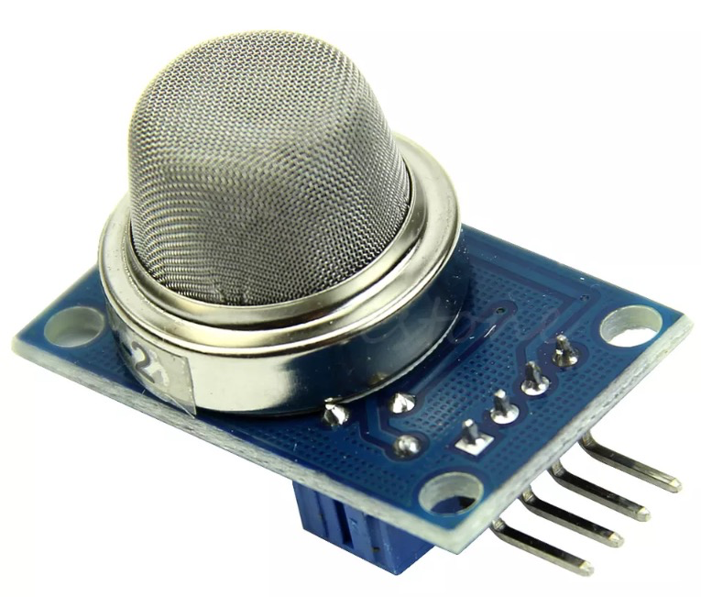
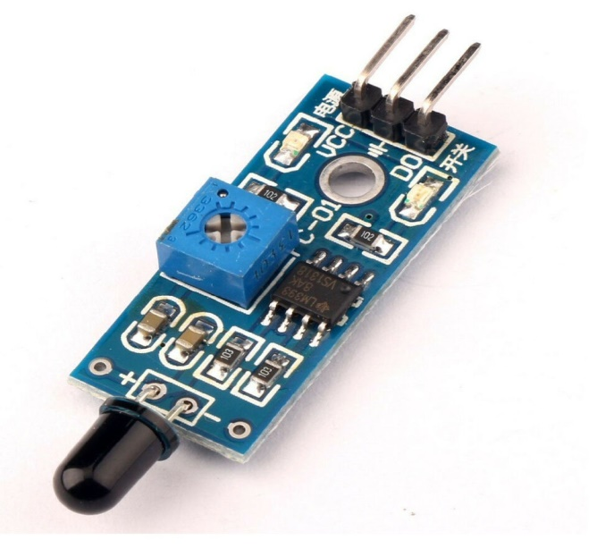
FOREST FIRE DETECTION AND EXTINGUISH
SENSOR
GAS (MQ2)
It’s used to detect the methane gas or other flammable gases.
FLAME
This detects the occurrence of a fire or flame.

Slide 6
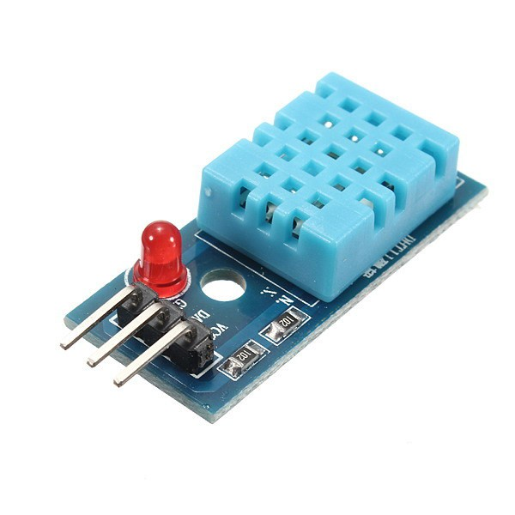
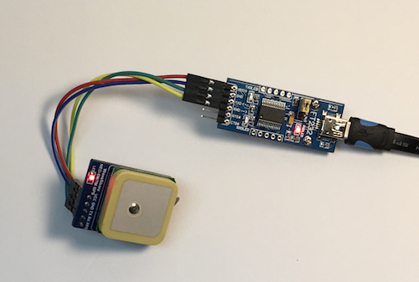
FOREST FIRE DETECTION AND EXTINGUISH
SENSOR
Temperature (DHT 11)
Temperature from 0 to 50 degree celcius
Humidity from 20% to 90%
GPS
It provides geolocation and time information to a GPS receiver

Slide 7
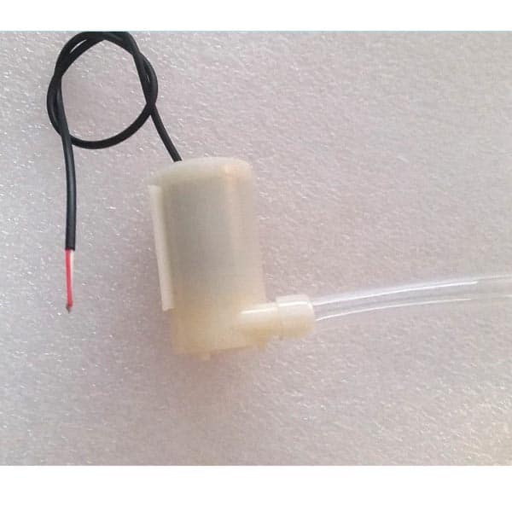
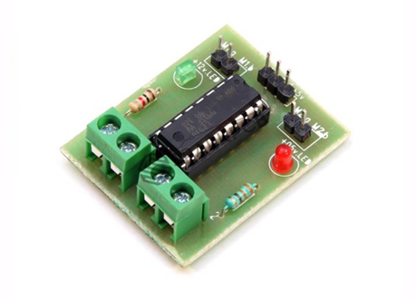
FOREST FIRE DETECTION AND EXTINGUISH
WATER PUMP (3-6V)
It’s used for the sprinkler that will help in extinguish or not to spread the fire.
MOTOR DRIVER (L293D)
It’s used to control the direction of water pumps
This IC can drive small and big motors.

Slide 8


FOREST FIRE DETECTION AND EXTINGUISH
JUMPERS WIRES
It’s used to connect the devices.
USB CABLES
It’s used to connect the NodeMCU with the Laptop for running the program.

Slide 9
FOREST FIRE DETECTION AND EXTINGUISH
EXECUTION OF PROJECT
Sensors will detect the fire, flammable gas, temperature (exceeding the limit).
GPS module will send the location of the place where fire is active.
Firebase Server will send the Alert notification.
Water pumps will get active of that location.

Slide 10
FOREST FIRE DETECTION AND EXTINGUISH
WORK DONE BY TEAM
Codes of all the sensors :- Temperature, Flame, Gas(MQ2), GPS
Code of the motor driver
Integration of the codes
Firebase sensor
Assembling of all the devices in the model.

Slide 11
FOREST FIRE DETECTION AND EXTINGUISH
What we thought new?
In every forest there are small ponds, canals , rivers etc.
We will assemble the water motor pumps there.
When the fire is active, the sprinklers will get activated and wet the place near the fire, so the fire will not get spread more.
By the time, the firebase server that we made will notify the authority about the location of the fire and they will reach their to extinguish it.

Slide 12
FOREST FIRE DETECTION AND EXTINGUISH
Motivation
We get the aspiration to do this project by seeing the destruction in Amazon rain forest, Australia forest fire etc.

Slide 13
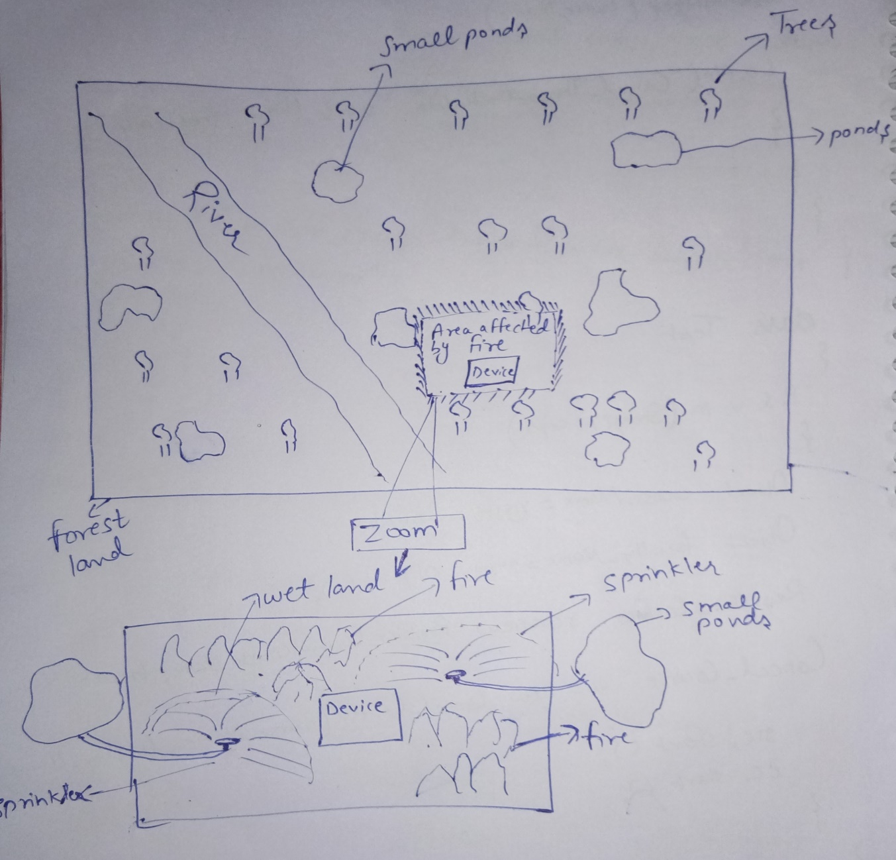
FOREST FIRE DETECTION AND EXTINGUISH
Blueprint

Slide 14
THANK YOU

